Slide 1
C Programming
Introduction to C, Programming Constructs and Arrays
Module 1

Slide 2
Agenda
1
Introduction to C
2
Operators in C
3
Control Statements in C
4
Arrays
5
Hands-on and Cases

Slide 3
Objectives
At the end of this module, you will be able to:
Describe genesis of C programming language
Identify features of C programming language
Define data types in C and implement basic I/O operations
Identify variety of unary, binary and conditional operators in C
Define program control through branching and looping
Implement branching (if, switch) and loops (do..while and for)
Define Arrays and illustrate 1D and 2D arrays

Slide 4
Delivery Plan
Topic | Objectives | Duration (in minutes)
Introduction | Describe genesis of C programming language Identify features of C programming language | 30
Operators | Define data types in C and implement basic I/O operations Identify variety of unary, binary and conditional operators in C | 45
Branching & Looping | Define program control through branching and looping Implement branching (if, switch) and loops (do..while and for) | 45
Arrays | Define Arrays and Illustrate 1D and 2D arrays | 90
Cases / Exercises | Write programs to solve given problems | 210

Slide 5
1. Introduction to C
Genesis of C, Tokens, data types and standard I/O functions

Slide 6
Computer Languages
Machine Language: A Binary Language composed of 0s and 1s – that is specific to each computer.
Assembly Language: Binary & Mnemonics based.
High Level Language: machine-independent.
Eg:FORTRAN,PASCAL,C ..etc.
Assembler is a program that translates the mnemonics into the corresponding binary machine codes of the microprocessor
  Eg: KEIL’s a51
Compiler is a program that translates the source code (statements) into the machine language (object code) compatible with the microprocessor used in the system.
  Eg: TURBO C, BORLAND C, GCC ..etc.

Slide 7
The C Language
C is a robust language whose rich set of built-in functions and operators can be used to write any complex program.
C compiler combines the capabilities of an assembly language with features of high-level language and therefore it is well suited for writing both system software and business packages.
Programs written in C are efficient and fast .This is due to its variety of data types and powerful operators.
Notes:
Currently, the most commonly-used language for embedded systems
Very portable: compilers exist for virtually every processor
Several built-in functions are available which can be used for developing programs.
C programs are highly portable ,programs written for one computer can be run on another with little or no modification.
C language is well suited for structured programming. The modular structure makes program debugging, testing and maintenance easier.

Slide 8
Welcome to C Programming
#include <stdio.h>
void main()
{
printf(“Welcome to C Programming!\n”);
}
Preprocessor used to share information among source files
Program mostly a collection of functions
“main” function special: the entry point
“void” qualifier indicates function does not return anything
I/O performed by a library function: not included in the language

Slide 9
Tokens of C
Types and Variables
  Definitions of data in memory
Expressions
  Arithmetic, logical, and assignment operators in an infix notation
Statements
  Sequences of conditional, iteration, and branching instructions
Functions
  Groups of statements and variables invoked recursively

Slide 10
Constants, Variables, Keywords and Identifiers
Constants are the quantities which do not change during the execution of a program.
Variables are the quantities which may vary during the execution of a program
Keywords are the words whose meaning has already been explained to the C compiler.
Identifiers are the user defined names given to variables, functions and arrays.
Notes:
Rules for constructing Integer Constants
It must not have a decimal point.
It could be either positive or negative.
If no sign precedes it is assumed to be positive.
No commas or blanks are allowed within the no.
An Integer constant must have at least one digit.
Rules for constructing Real Constants
A real constant must have at least one digit.
It must have a decimal point.
It could be either positive or negative.
Default sign is positive.
No commas and blanks are allowed within the no.
Eg: 426.0 ,-32.76,-48.5879
Rules for constructing Character Constants
A character constant is either a single alphabet, a single digit or a single symbol within single inverted (both left)commas.
The max length of the of a char constant can be 1 character.
Eg: ’A’

Slide 11
C variables
Variable names are names given to the memory locations of a computer where different constants are stored.
These locations can contain integer, real or character constants.
The rules of constructing variable names of all types are same.
  A variable name is any combination of 1 to 8 alphabets, digits or underscores.
  The first character must be alphabet.
  No commas and blanks are allowed within the variable name.
  No special symbol other than an underscore can be used in a variable name.
  Eg: si_int, pop_e_89

Slide 12
C Data Types
Data type | Byte | Format
char | 1 | %c
signed int | 4 | %d
unsigned int | 4 | %u
short int | 2 | %d
float | 4 | %f
double | 8 | %lf
Notes:
Basic types: char, int, float, and double
Meant to match the processor’s native types
Natural translation into assembly
Fundamentally non-portable
Declaration syntax: string of specifiers followed by a declaration
Declarator’s notation matches that in an expression

Slide 13
C Data Types
Basic built-in data types in C
  int
  float
  double
  char
Modifiers - The data types can have the following modifiers. The modifiers define the amount of storage allocated to the variable.
  short
  long
  signed
  unsigned

Slide 14
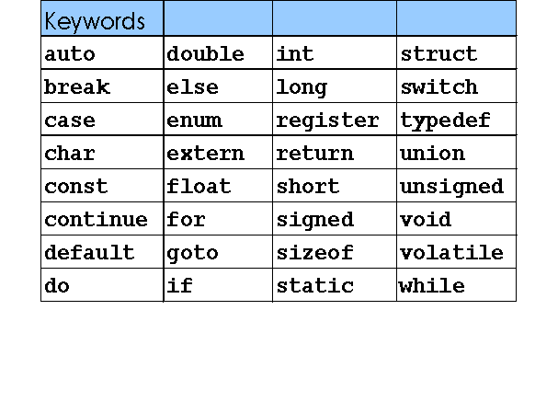
C Keywords
Keywords are the words whose meaning has already been explained to the C compiler. The keywords cannot be used as variable names .
Doing so is trying to assign a new name to the keyword which is not allowed by the compiler. Keywords are also called as Reserved words.
There are only 32 keywords available in C.

Slide 15
C Instructions
Type declaration :To declare the type of variables used in the program.
Input / Output instructions: To perform the function of supplying input data to a program and obtaining the output results from it.
Arithmetic instructions: To perform arithmetic operations between constants and variables.
Control instructions: To control the sequence of execution of various statements.

Slide 16
C program
Any C program is basically a collection of functions that are supported by the C library. User defined functions can be added to the C library.
The main( ) is a special function used by the C system to tell the computer where the program starts.
The set of statements belonging to a function are enclosed within a pair of braces { }.
Any Variable used in the program must be declared before using it.
C program statements are written in lowercase letters and end with semicolon
C compiler is case-sensitive, i.e. ‘amount’ is not the same as ‘Amount’ or ‘AMOUNT’
As a good coding practice, all C variables are written in lowercase, and all symbolic constants are named in UPPERCASE.

Slide 17
Basic Structure of C program
Link Section
Definition Section
Global Declaration Section
main( )
{
Declaration Part(local)
Execution Part
function call
}
function()
{
Declaration Part(local)
Execution Part
}

Slide 18
Standard Output function – printf()
printf( ) is predefined, standard C function for printing output.
The general form of printf() is,
printf(“<format string>”,<list of variables>);
<format string> could be,
%f for printing real values
%d for printing integer values
%c for printing character values
%s for printing string
Eg: printf(“%f”,si);
printf(“%d”,i);

Slide 19
Display a single character – putchar()
putchar() – a function used to display a single character
it takes a single parameter which can be a
- character constant
- character variable
Eg : void main()
{
char cvar; // declaring a variable called cvar
cvar = ‘A’; // assigning a character ‘A’ to cvar
putchar(cvar); // displaying the contents of cvar
putchar(‘\n’); // displaying a new line character
}

Slide 20
Standard Input function scanf() statement
scanf( ) is a predefined standard C function used to input data from keyboard.
The general form of scanf() is
scanf(“<format string>”,<address of variables>);
Eg: scanf(“%d”,&n);
scanf(“%f”,&interest);
& is pointer operator which specifies the address of that variable.

Slide 21
Input functions – getchar()
Other input functions that could be used are
getchar()
getche()
getch()
getchar() – reads a single character
- the character is read from the keyboard buffer only after <enter> key is encountered
- it returns a character
- it does not take any parameter
Eg : void main()
{
char c1,c2;
c1 = getchar(); // reads a single character from keyboard buffer
c2 = getchar(); // reads a single character from keyboard buffer
putchar(c1); // displays the character present in c1
putchar(c2); // displays the character present in c2

Slide 22
Input functions – getche(), getch()
getche() – scans the keyboard for a character
- does not read the character from the keyboard buffer
- character scanned is echoed on the monitor
- it returns the character read
- it does not take any parameter
getch() - similar to getche() except that the character entered is not echoed
Eg : void main()
{
char c1,c2;
c1 = getche(); // reads a single character from keyboard echos character
c2 = getche();
putchar(c1); // displays the character present in c1
putchar(c2);
c1 = getch(); // reads a single character from keyboard and does not echo the character read
c2 = getch(); // reads a single character from keyboard and does not echo the character read
putchar(c1);
putchar(c2); }

Slide 23
2. Operators in C
Unary, binary, terinary, logical, arithmetic, increment / decrement operators and type conversions

Slide 24
C Expressions & Operators
Traditional mathematical expressions
y = a*x*x + b*x + c;
An Operator is a symbol that tells the computer to perform certain mathematical or logic manipulations. Operators are used in programs to manipulate data and variables.
C Operators can be classified as
  Arithmetic Operators. + – * / %
  Logical Operators. && || !
  Relational Operators. == != < <= > >=
  Bit wise Operators & | ^ ~
  Assignment Operators. = += -=
  Increment & Decrement Operators. ++ --
  Conditional Operators. ? :

Slide 25
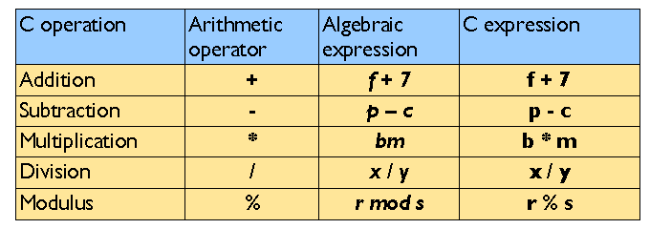
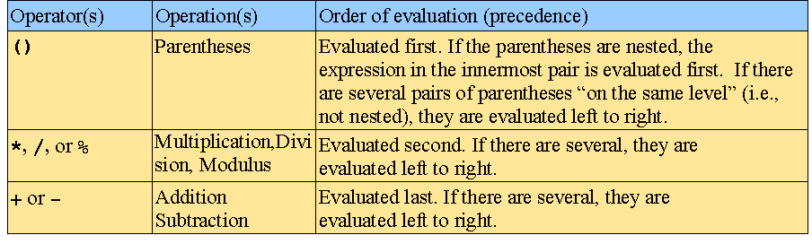
Arithmetic Operators
Arithmetic operators:
Rules of operator precedence:

Slide 26
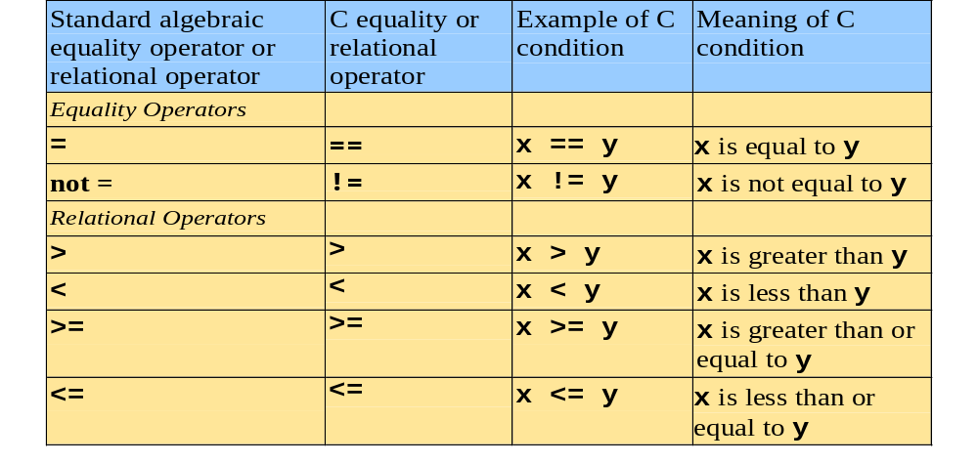
Equality and Relational Operators
Decision Making operators

Slide 27
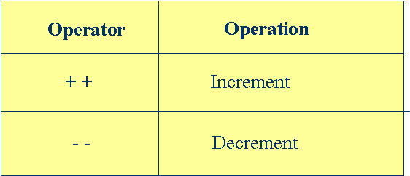
Increment & Decrement Operators
The increment and decrement operators are unary operators.
The operator ++ adds 1 to the operand while - -subtracts 1.They take the following form:
++m(pre increment); or m++(post increment);
--m(pre decrement); or m--(post decrement);
Prefix operator first does the operation and then result is assigned to the variable.
Postfix operator first assigns the value to the variable and then does the operation.
Notes:
++m and m++ mean the same thing when they form statements independently.
They behave differently when they are used in expressions on the right hand side of the assignment.
Unary operators, as the name suggests, works on one operand or variable.
Incrementing and decrementing by 1 is such a ubiquitous operation that C offers the prefix and postfix implementations of the ++ and the -- operators.
The expression i = i + 1; can also be written as i++.
When used as a standalone statement, writing i++, or ++i does not make any difference at all.
It is only when they are used as part of an expression that the prefix and the postfix operators can have totally different results.

Slide 28
Conditional/ Ternary Operator
A Ternary operator pair “ ? :”is available in C to construct conditional expression of the form
expression1 ? expression2 : expression3
Eg:
a=10;
b=15;
x=(a>b) ? a : b;
x will be assigned to the value of b.

Slide 29
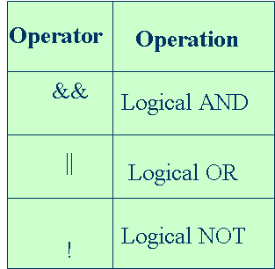
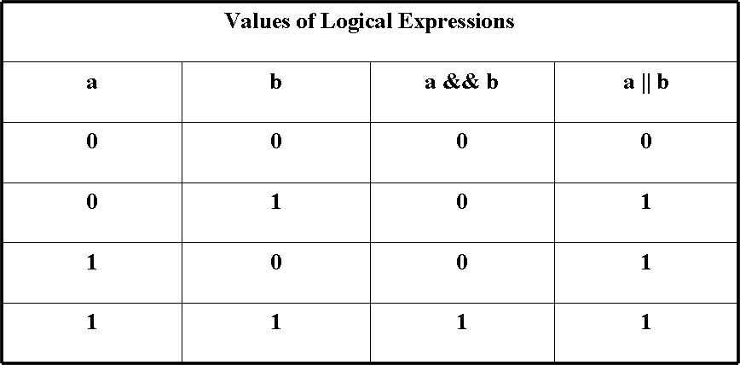
Logical Operators
The Logical AND Operator
  a && b;
  (a < b) && (c < d)
The Logical OR Operator
  a || b
  (a < b) || (c < d)
The Logical NOT Operator
  !a
  !(x + 7)
Notes:
The logical operators act on operands which are themselves logical expressions
The result of a logical AND operation is true if both operands are true.
And evaluates to 1 (true) if both expression1 and expression2 are 1 (true); otherwise evaluates to false even if one of them evaluates to 0 (false).

Slide 30
Assignment Operators
Operator | Operation
a = 1 | Assignment
a += 1 | a = a+1
a -= 1 | a = a-1
a *= b | a = a*b
a /= b | a = a/b
a %= b | a = a%b
Notes:
Compound assignment statements help in simplifying, and writing simple code.
So far, we have been writing statements such as:
sum = sum + num
The same could be simplified as
sum += num;
The same applies to the other binary operators.

Slide 31
Type Conversions
When an operator has operands of different types, they are converted to a common type according to a small number of rules.
The following informal set of rules will suffice:
  If either operand is long double, convert the other to long double.
  Otherwise, if either operand is double, convert the other to double.
  Otherwise, if either operand is float, convert the other to float.
  Otherwise, convert char and short to int.
  Then, if either operand is long, convert the other to long.
Conversions take place across assignments; the value of the right side is converted to the type of the left, which is the type of the result.
Notes:
The implicit conversions expressions that might lose information, like assigning a longer integer type to a shorter, or a floating-point type to an integer, may result a warning, but they are not illegal.
A char is just a small integer, so chars may be freely used in arithmetic expressions.
Implicit conversions work much as expected. In general, if an operator like + or * that takes two operands (a binary operator) has operands of different types, the “lower'' type is promoted to the ``higher'' type before the operation proceeds.

Slide 32
Type Conversions (Contd.).
Consider the following assignments:
    int i;
    char c;
    i = c;
In the aforesaid assignment, the data type on the right (char) is converted to the data type on the left (int) which is the type of the result.
If x is float and i is int, then x = i and i = x both cause conversions; float to int causes truncation of any fractional part. When a double is converted to float, whether the value is rounded or truncated is implementation dependent.

Slide 33
Explicit Type Conversion
In the construction (type name) expression, the expression is converted to the named type by the conversion rules above.
Consider the following example:
  int i, j;
  double d;
  d = i / j; /* double assigned the result of the division of two integers */
The problem with the above assignment is that the fractional portion of the above division is lost, and d is effectively assigned the integer quotient of the two integers i and j.
Notes:
For example, inbuilt function sqrt expects a double argument, and will produce nonsense if inappropriately handled something else.
So if n is an integer, we use sqrt((double) n)
explicit type conversions can be forced (coerced) in any expression using cast operator.

Slide 34
Explicit Type Conversion (Contd.).
To resolve this, the variable i can be type cast into a double as in:
d = (double)i / j;
int i is converted to a double using the explicit cast operator. Since one of the operands is a double, the other operand (j) is also converted to a double, and the result is a double.
The result is assigned to a double with no side effects. The cast operator can be done only on the right-hand side of an assignment.

Slide 35
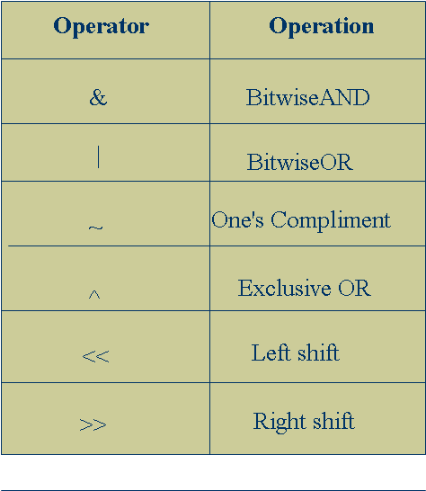
Bit-wise Operators
Bit-wise operators allow direct manipulation of individual bits within a word.
These Bit-manipulations are used in setting a particular bit or group of bits to 1 or 0.
All these operators work only on integer type operands.
  Bit-Wise logical operators:
  Bit-Wise AND (&)
  Bit-Wise OR ( | )
  Bit-Wise exclusive OR (^)
These are binary operators and require two integer-type operands.
  These operators work on their operands bit by bit starting from the least significant bit
Notes:
Bit-Wise AND is often used to test whether a particular bit is 1 or 0.
Bit-Wise Shift Operators:
Left shift : op<<n;
Right shift: op>>n;
Left shift operation results all the bits in the operand op to be shifted to the left by n positions.
Right shift operation results all the bits in the operand op to be shifted to the right by n positions.

Slide 36
sizeof operator
The sizeof is a compile time operator and,when used with an operator, it returns the number of bytes the operand occupies
The operand may be a variable,a constant or a data type qualifier
  Eg: int m,n, sum;
  m=sizeof(sum);
  n=sizeof(long int);
The sizeof operator is normally used to determine the lengths of arrays and structures
It is also used to allocate memory space dynamically to variables during execution of a program

Slide 37
3. Control Statements in C
Branching ( if and switch) , loops( do..while and for loop)

Slide 38
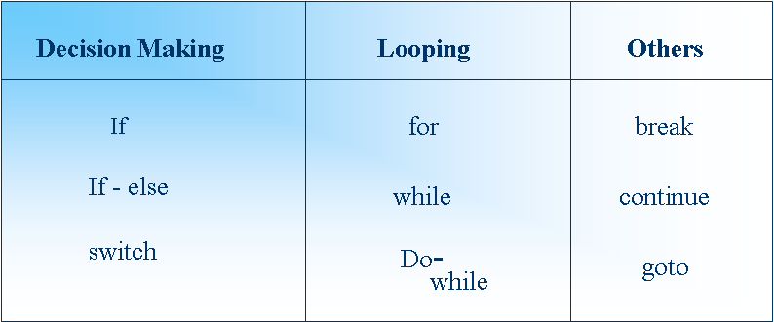
Control Structures
These are the statements which alter the normal (sequential) execution flow of a program.
There are three types of Control Statements in C

Slide 39
if statement
The general form :
if(test expression)
{
statement–block;
}
statement-x;
Entry
test expression ?
True
statement–block
False
Statement-x

Slide 40
if….else statement
The if….else statement is an extension of simple if statement. The general form is,
if(test expression)
{
true-block statements;
}
else
{
False-block statements;
}
statement-x;
Entry
Test expression?
False
True
True-block
False-block
Statement-x

Slide 41
Cascading if- else Construct
The cascading if-else construct is also known as the multiple if-else construct.
On the first condition evaluating to false, the else part of the first condition consists of another if statement that is evaluated for a condition.
If this condition evaluates to false, the else part of this if condition consists of another if statement that is evaluated for a condition, and so on.

Slide 42
Nested if Construct
A nested if statement is encountered if the statement to be executed after a condition evaluates to true is another if statement.
Both the outer if statement and the inner if statement have to evaluate to true for the statement following the inner if condition to be executed.
no
yes
”
yes
no

Slide 43
switch statement
The switch statement tests the value of a given variable(or expression) against a list of case values and when a match is found, a block of statements associated with that case is executed.
The break statement at the end of each block signals the end of particular case and causes an exit from the switch statement, transferring the control to the statement-x.
The default is an optional case. When present, it will be executed if the value of the expression does not match any of the case values.
If default not present, no action takes place if all matches fail and control goes to statement-x.
switch (expression)
{
case value-1 :
case-1 block
break;
case value-2 :
case-2 block
break;
default :
default block
break;
}
Notes:
A switch-case statement makes for more readability & better understandable code.
The switch-case statement is used in situations where based on the value of a variable, certain actions need to be taken.
The case statements with either integer or character constants. They also specify the action to be taken if the value specified in the case statement matches with the value of the switch variable.
If the break statement is not specified after the each case statement, then subsequent case statements will be executed.
This is because when one of the case statements is evaluated as true, the action statements are executed until a break statement sends control out of the switch block of statements, or the switch block comes to an end.

Slide 44
Iterative Constructs - The while Loop
In a while loop, the loop condition is written at the top followed by the body of the loop.
Therefore, the loop condition is evaluated first, and if it is true, the loop body is executed.
After the execution of the loop body, the condition in the while statement is evaluated again. This repeats until the condition becomes false.
General form
  while(test-condition)
  {
  body of the loop
  }
Evaluate Condition
false
true
Execute body of loop

Slide 45
do…while loop
The general form of do..while loop is
  do
  {
  body of the loop
  } while (test-condition) ;
The do..while construct provides an exit-controlled loop as the test-condition is evaluated at the bottom of the loop and therefore the body of the loop is always executed at least once.
Execute body of loop
Evaluate Condition
false

Slide 46
for loop
The for loop is another entry-controlled loop that provides a more concise loop structure
  for(initialization; test-condition; increment / decrement)
  {
  body of the loop
  }
Initialization of the control variable is done first using assignment statements.
Notes:
For loop is considered to be the most genuine loop as it contains good readability. As all the expressions are placed at one single statement, it will be easier to estimate the loop executions. The first part is executed before the loop is entered. This is usually the initialization of the loop variable. Second being the condition and third generally will be increment/ decrement operators to go forward/backward in the loop.

Slide 47
Features of for loop
Initializing, testing and incrementing are placed in the for loop itself, thus making them visible to the programmers and users, in one place.
The for statement allows for negative increments. More than one variable can be initialized at a time.
for (p=1,n=0;n<17;++n)
The increment section can also have more than one part.
for (n=1,m=50;n<=m;m++,n--)
One or more sections can be omitted, if necessary.
for(;m!=0;)
** The semicolons separating the sections must remain.
If the test-condition is not present, the for statement sets up an infinite loop.
for(i=0; ;i++)
Notes:
Time delay loops can be set up using the null statements.
for(j=1000;j>0;j--);

Slide 48
Control of Loop Execution
A loop construct, whether while, or do-while, or a for loop continues to iteratively execute until the loop condition evaluates to false.
The break statement is used to exit early from all loop constructs (while, do-while, and for)
The continue statement used in a loop causes all subsequent instructions in the loop body (coming after the continue statement) to be skipped.
Notes:
Incase if any particular iterations within the loop or switch case need to be skipped from execution or to discontinue for subsequent iterations “CONTINUE” and “BREAK” are the two statements provided in C.

Slide 49
break and continue statements
When a break statement is encountered in a loop, the loop is exited and the program continues with the statements immediately following the loop.
When the loops are nested, The break would only exit from the loop containing it.
continue statement causes the loop to be continued with the next iteration after skipping any statements in between.
In while and do loops, continue causes the control to go directly to the test-condition and then continue the iteration process.
In case of for loop, the increment section of the loop is executed before the test-condition is evaluated

Slide 50
C Statements
Expression
Conditional
  if (expr) { … } else {…}
  switch (expr) { case c1: case c2: … }
Iteration
  while (expr) { … } zero or more iterations
  do … while (expr) at least one iteration
  for ( init ; valid ; next ) { … }
  continue; go to start of loop
  break; exit loop or switch
  return expr; return from function

Slide 51
4. Arrays
Introduction to Arrays, 1D and 2D arrays

Slide 52
Arrays
An array is a group of related data items that share a common name.
int a[10];
The individual values are called elements.
The elements are a[0] ,a[1] , a[2]……a[9].
The elements are stored in continuous memory locations during compilation.
The name of the array(a)contains the address of the first location i.e a[0].
The elements of the array are physically and logically adjacent.
When an array is passed as an argument to a function, its address is actually passed.
Data type
Index(size)
Notes:
Array: sequence of identical objects in memory
int a[10]; means space for ten integers
By itself, a is the address of the first integer
*a and a[0] mean the same thing
The address of a is not stored in memory: the compiler inserts code to compute it when it appears
Each array element shares the same name as the array name, but distinguishes itself from other elements in the array using a subscript, or an index.
The subscript or the index of each array element is determined based on the number of offset positions it has.

Slide 53
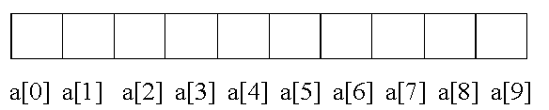
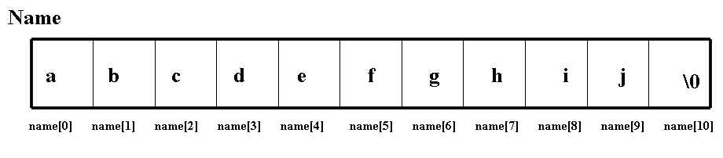
Array Representation
int a[10];
/*defines an array a of size 10, as a block of 10 contiguous elements in memory */
Character Arrays
  Char name[11];
  To define a character array, need to define a array of size n+1 characters.
  This is because all character arrays are terminated by a NULL character (‘\0’)
  where name[0] through name[9] will contain the characters comprising the name, and name[10] will store the NULL character

Slide 54
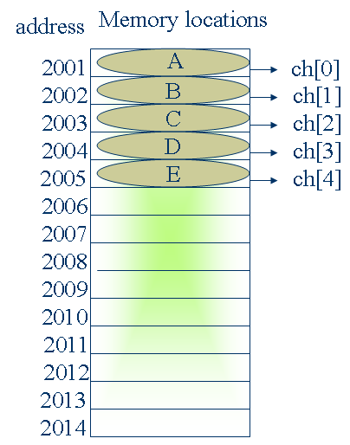
Array - Memory allocation
char ch[5]={ ‘A’,’B’,’C’,’D’,’E’};
or
ch[0]=‘A’;
ch[1]=‘B’;
ch[2]=‘C’;
ch[3]=‘D’;
ch[4]=‘E’;
Note: Memory allocation is done by OS.

Slide 55
Array Initialization
Since an array is a set of elements located at contiguous memory locations, its initialization involves moving element by element, or one data at a time into the array.
char array1[ ] = {‘A’, ‘R’, ‘R’, ‘A’, ‘Y’, ‘\0’};
char array2[ ] = {“ARRAY”};
int values1[ ] = {10, 20, 30, 40,0};
float values2[ ] = {100.56, 200.33, 220.44,0};
Notes:
An array is initialized by specifying each element in an initialization list separated by commas.
The size of the array, in this case, may or may not be specified. The number of elements stored in the array determines its size.
A character array needs a string terminator, the NULL character (‘\0’) as the last character, whereas integer and float arrays do not need a terminator.

Slide 56
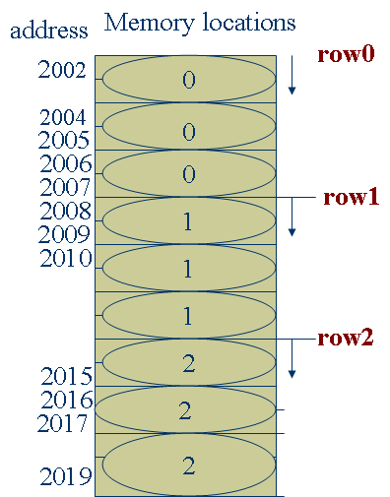
Two-Dimensional Arrays
Declaration:
type array_name[rowsize][columnsize];
Eg:
int m[3][3]={0,0,0,1,1,1,2,2,2};
m[0][0] m[0][1] m[0][2]
m[1][0] m[1][1] m[1][2]
m[2][0] m[2][1] m[2][2]
Address
2000
2004
2008
2012
2016
2020
2024
2028
2032
In multi-dimensional arrays, elements are stored sequentially row wise in memory.
Notes:
While a one-dimensional array can be visualized in one-dimension as either a row of elements, or a column of elements, a two-dimensional array needs to be visualized along two dimensions, i.e., along rows and columns.
To be precise, a two-dimensional array can be represented as an array of m rows by n columns.
A general way of representing or visualizing a two-dimensional array is in the form of a two-dimensional grid. But, in memory, even a two-dimensional array is arranged contiguously as an array of elements.

Slide 57
Two-dimensional Arrays (Contd.).
Scenario: Consider a situation where you want to record the region-wise, product-wise figures of sales. The regions are col1, col2 and col3. The products are r1, r2 and r3.
Sales data for the region-wise, product-wise breakup can be shown as :
col 0
col 1
col 2
row 0
row 1
row 2
r0,c0
r0,c1
r0,c2
r1,c0
r1,c1
r1,c0
r2,c0
r2,c1
r2,c2

Slide 58
Two-Dimensional Array – Declaration, Initialization
Declaring a two-dimensional array involves two indices, or two subscripts. There will be an extra set of [ ] to indicate the second subscript, or the second index.
int rp_array[3][3] = { 0,0,0,
0,0,0,
0,0,0
};
To improve the legibility of the initialization, it can be written as:
int rp_array[3][3] = { {0,0, 0},
{0, 0, 0},
{0, 0, 0}
};
Notes:
To declare a two-dimensional array for accommodating sales data for three regions and three products, we would come out with an array declaration as in:
int rp_array[3][3];
/* this array would have nine elements starting at rp_array[0][0], rp_array[1][1]…….and going on till rp_array[2,2] */

Slide 59
Two-Dimensional Character Arrays
If you were to store an array of 11 names, with each name containing up to a maximum of 30 characters, you would declare it as a two-dimensional character array such as: char name[11][31];
Here, name[0] through name[10] would store character strings representing names of 30 characters each.
The first index represents the number of names, and the second index represents the maximum size of each name.
char team_india [11][30] = {
    “Gambir”,
    “Virendra Sehwag”,
    “Rahul Dravid”
    “Sachin Tendulkar”,
    “Suresh Raina”,
    “Yuvraj Singh”,
    “Murali Vijay”,
    “Irfan Pathan”,
    “Praveen Kumar”,
    “Zaheer Khan”,
    “Yousuf Pathan”
  };
Notes:
Particular elements can also be printed from a two dimensional array by using the second subscript.
printf(“%c”, team_india[10][7] would print the character ‘P’ from the string “Pathan”

Slide 60
Pre processor Directive - #include, #define
#include
- It is a preprocessor directive
- it is used to include header files in the program
Eg:
#include <stdio.h>
#include <conio.h>
#include <string.h>
#define
- it is a preprocessor directive
- compiler replaces #defined values in the program before it starts compilation
Eg: #define MAX 100
void main()
{
int k[MAX]; // during compilation MAX is replaced with 100
…..
}

Slide 61
5. Hands-on and Cases

Slide 62
Exercises
Purpose: Implement various categories of operators, data types, conditional & iterative constructs
Write a C program to accept a centigrade value and display its equivalent in Fahrenheit. Hint: Fahrenheit = (9/5) * tc + 32;
Write a program to accept principal amount, rate of interest and duration. Calculate the simple interest and display all the values in a neat format. Hint: Simple Interest = p * t * r / 100
Write a program to accept three numbers and display the greatest number.
Write a program to accept a number from 1 to 7. Display the weekday with 1 represented as Sunday.
Write a program to read in 10 numbers and compute the average, maximum and minimum values.

Slide 63
Exercises (Contd.).
Write a program to display an electricity bill. Accept the previous meter reading, current meter reading. Calculate the units consumed. Calculate the bill amount as per the following criteria:
  Units Price
  0 – 200 Rs.1/ unit
  201 – 400 Rs.2/ unit
  >400 Rs.5/ unit
Write a solution to find the income tax of an employee
  Input: total taxable income of an employee, Employee ID
  Output: Total tax on income
Gross taxable Salary range | Tax percentage
<=1,50,000 | 0%
>150,000 and <=300000 | 10%
>300000 and <=500000 | 20%
>500000 | 30%

Slide 64
Exercises (Contd.).
Write a program to accept the marks percentages of 10 students. Display the marks and count of students who have scored above the average.
Write a program to accept a name and display the number of vowels and consonants. Also display the name vertically.
Write a program to accept values into a 2 dimensional array with 5 rows and 5 columns and display the values in the form of rows and columns. Display the row total and column total for each row and column.

Slide 65
Additional Exercises
Find first n prime numbers
Find the sum of 1+22+32+-----------+n2
Find biggest of three numbers
Find whether given year is leap year or not
Find reverse of a number n
Write a program to read an integer value. Assuming it is the number of a month of the year; print out the name of that month
Write a program to accept the valid marks scored by a student in 5 subjects. Calculate the marks percentage and find the result as per the following criteria:
  Marks Result
  70 – 100 Distinction
  60 – 69 I Class
  50 – 59 II Class
  35 – 49 III Class
  0– 34 Fail

Slide 66
Case - 1
//Observe the code below, and correct all the syntax errors:
#include<stdio.h>
void main()
{
//char cvar='A';
char cvar;
printf('\nEnter a character : ");
scanf("%c",cvar);
switch(cvar)
{ case 'A':
case 'E':
case 'I':
case 'O':
case "U":puts("vowel");
default:puts("Not an vowel");
}
}

Slide 67
Case - 2
//Go through the code and display the message using each of the methods
//Check and correct errors if any :
      #include<stdio.h>
      void main()
      { int cont;
      cont=1;
      /* Method 1:
      printf("\n c language ");
      printf("\nc language");
      printf("\nc language");
      printf("\ nc language ");
      printf("\n c language ");
      printf("\n c language ");
      */
      // Method 2 : while
      while(cont<=5)
      { printf("\n c language ");
      cont++;
      }

Slide 68
Case - 2 (Contd).
        // Method 3 : do while
        /*
        do
        {
        printf("\ nc language ");
        cont++;
        }while(cont<5);
        */
        // Method 4 : for
        /*
        for(;cont<=5;cont++);
        printf("\ nc language ");
        cont++;
        */
        printf("\n\n");
        }

Slide 69
Case - 3
//Go through the code and fill up the blanks in putchar to display the contents of character variables
      #include<stdafx.h>
      void main()
      { char v1,v2,v3,v4,v5;
      v1='W';
      v2='I';
      v3='P';
      v4='R';
      v5='O';
      // Method 1 :
      putchar(...);
      putchar(...);
      putchar(...);
      putchar(...);
      putchar(...);
      // Alternate Method :
      putchar('\n'); }

Slide 70
Case - 4
//The following program accepts 5 characters and displays them.
//Correct errors if found in any of the methods
#include<stdio.h>
#include<conio.h>
void main()
{
char v1,v2,v3,v4,v5;
printf("\nEnter 5 characters : ");
// Method 1 : using scanf()
scanf("%d%d%d%d%d“,&v1,&v2,&v3,&v4,&v5);
// Method 2 : using getchar()
/* getchar(v1);
getchar(v2);
getchar(v3);
getchar(v4);
getchar(v5);
*/

Slide 71
Case - 4 (Contd.).
// Method 3 : using getche()
/*
v1=getche();putchar('*');
v2=getche();putchar('*');
v3=getche();putchar('*');
v4=getche();putchar('*');
v5=getche();putchar('*');
*/
// Method 4 : using getch()
v1=getch();putchar('*');
v2=getch();putchar('*');
v3=getch();putchar('*');
v4=getch();putchar('*');
v5=getch();putchar('*');
// Display the characters
printf("\nEntered characters are %c%c%c%c%c\n\n“, &v1,&v2,&v3,&v4,&v5);
}

Slide 72
Case - 5
//Go through the program and specify the output and explanation of the result obtained
#include "stdio.h”
void main()
{
int a,b;
a = 1;
b = (++a )+ (a++);
printf("\na=%d\tb=%d\n",a,b);
printf("\n%d\t%d", a, a++);
}

Slide 73
Summary
In this module, we discussed:
Genesis of C
Data types in C
Unary, binary, ternary, compound assignment operators, increment/ decrement operators
Conversion types between different data types
Conditional constructs and iterative constructs in C
1D and 2D Arrays

Slide 74
Quiz
1. int and long are ____ and _____ type of datatypes.
A variable in C program can be declared and defined any number of times ( True / False)
Consider integer variable takes 2 bytes. If m= sizeof( 2); n = sizeof(‘2’); k = sizeof( “2”); then values of m, n and k respectively are
    2,1,2 b) 2,2,2 c) 2,1,2 d) 1,1,1
int main()
{ double k=296 / 128; printf("%Lf",k); }
Where and what type of type casting to be given in above expressions to get an accurate double value as result?
5. int main () { Int i=5; while ( i<10) printf(“ hi”); i++ ; }
how many times does “hi” get displayed from above code?
In order to execute loop statements at least for one time irrespective of loop condition which loop to be utilized?
Which command is used to avoid certain iterations within a loop?

Slide 75
References
Java Samples. Fundamentals of languages and typecasting operators. Retrieved on Apr 10, 2012, from http://www.java-samples.com/showtutorial.php?tutorialid=498
Kernighan, Brian W and Ritchie, Dennis M. The C programming Language. New Delhi: Prentice-Hall, 1988.
Nguyen, Huong (2009). Data Types and Expressions. Retrieved on Apr 10, 2012, from, http://cnx.org/content/m27741/latest/

Slide 76
Thank You

